Slide 2
Presentation Overview
Tanzania HIV profile towards 3, 90’s
Data Accessibility and Usage at lower level
Trend Analysis of Hospital Mortality and Cause of Death in Mainland Tanzania Year (2006 – 2015)
On going country initiatives to strengthen availability and use of quality HIV data and other interventions

Slide 3
Introduction
Tanzania has adopted UNAIDS 90-90-90 targets by 2020 to end HIV as a public health problem by 2030
Tanzania has a population projection of over 54 mills (2018)
The life expectance at birth is 62yrs
Prevalence of HIV among adult age 15 – 64 is 5.0% (THIS 2016/17)
HIV Prevalence among Key, and Vulnerable Populations(KVP) FSW: 27%, MSM: 17.4%, PWID: 15.5% (Key population survey 2016)

Slide 4
Current National Progress towards 90-90-90
PLHIV is from Spectrum file of 2017 All other data are programme DHIS2 data

Slide 5
Current on Treatment by Age and Sex by March 2018
Source: Program DHIS2 data

Slide 6
Trend of performance TB/HIV Services to TB patients
Source: Program DHIS2 data

Slide 7
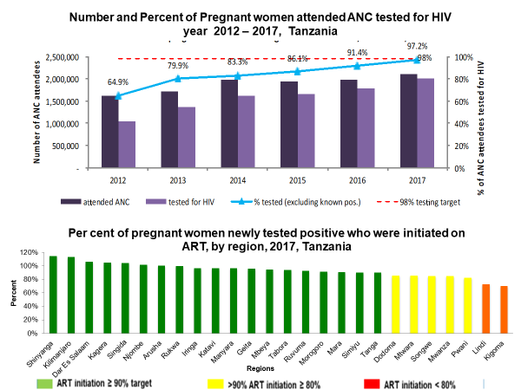
Source: Program DHIS2 data

Slide 8
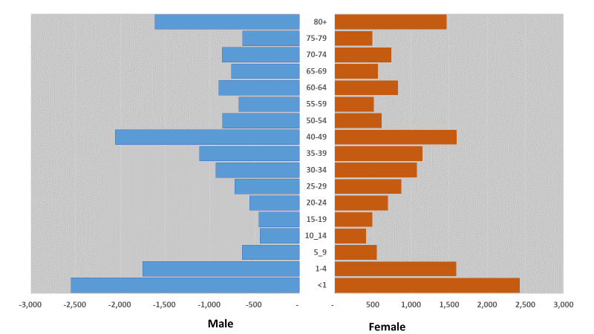
Tanzania Submit data on Cause of Death to the World Health Organization ICD – 10 Department Year 2017
Tanzania Population Pyramid 2017
Cause of Death year 2017
Source: DHIS2 Data

Slide 9
Accessibility and Usage of Tanzania Health Data

Slide 10
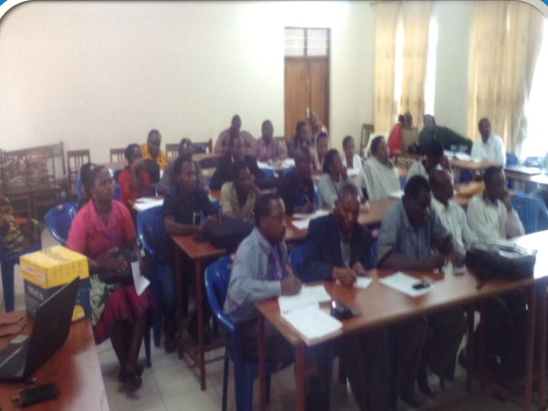
Health facility in-charges on data feedback meeting with Council Health Management Team (CHMT)

Slide 11
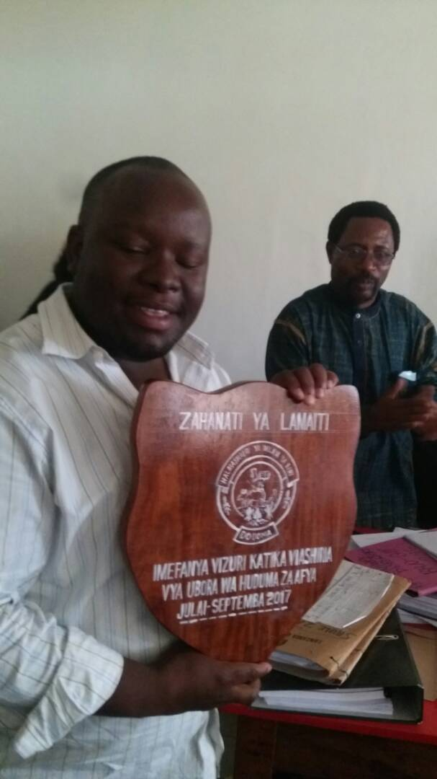
High performing Health Facilities on data quality and indicator coverage are rewarded

Slide 12
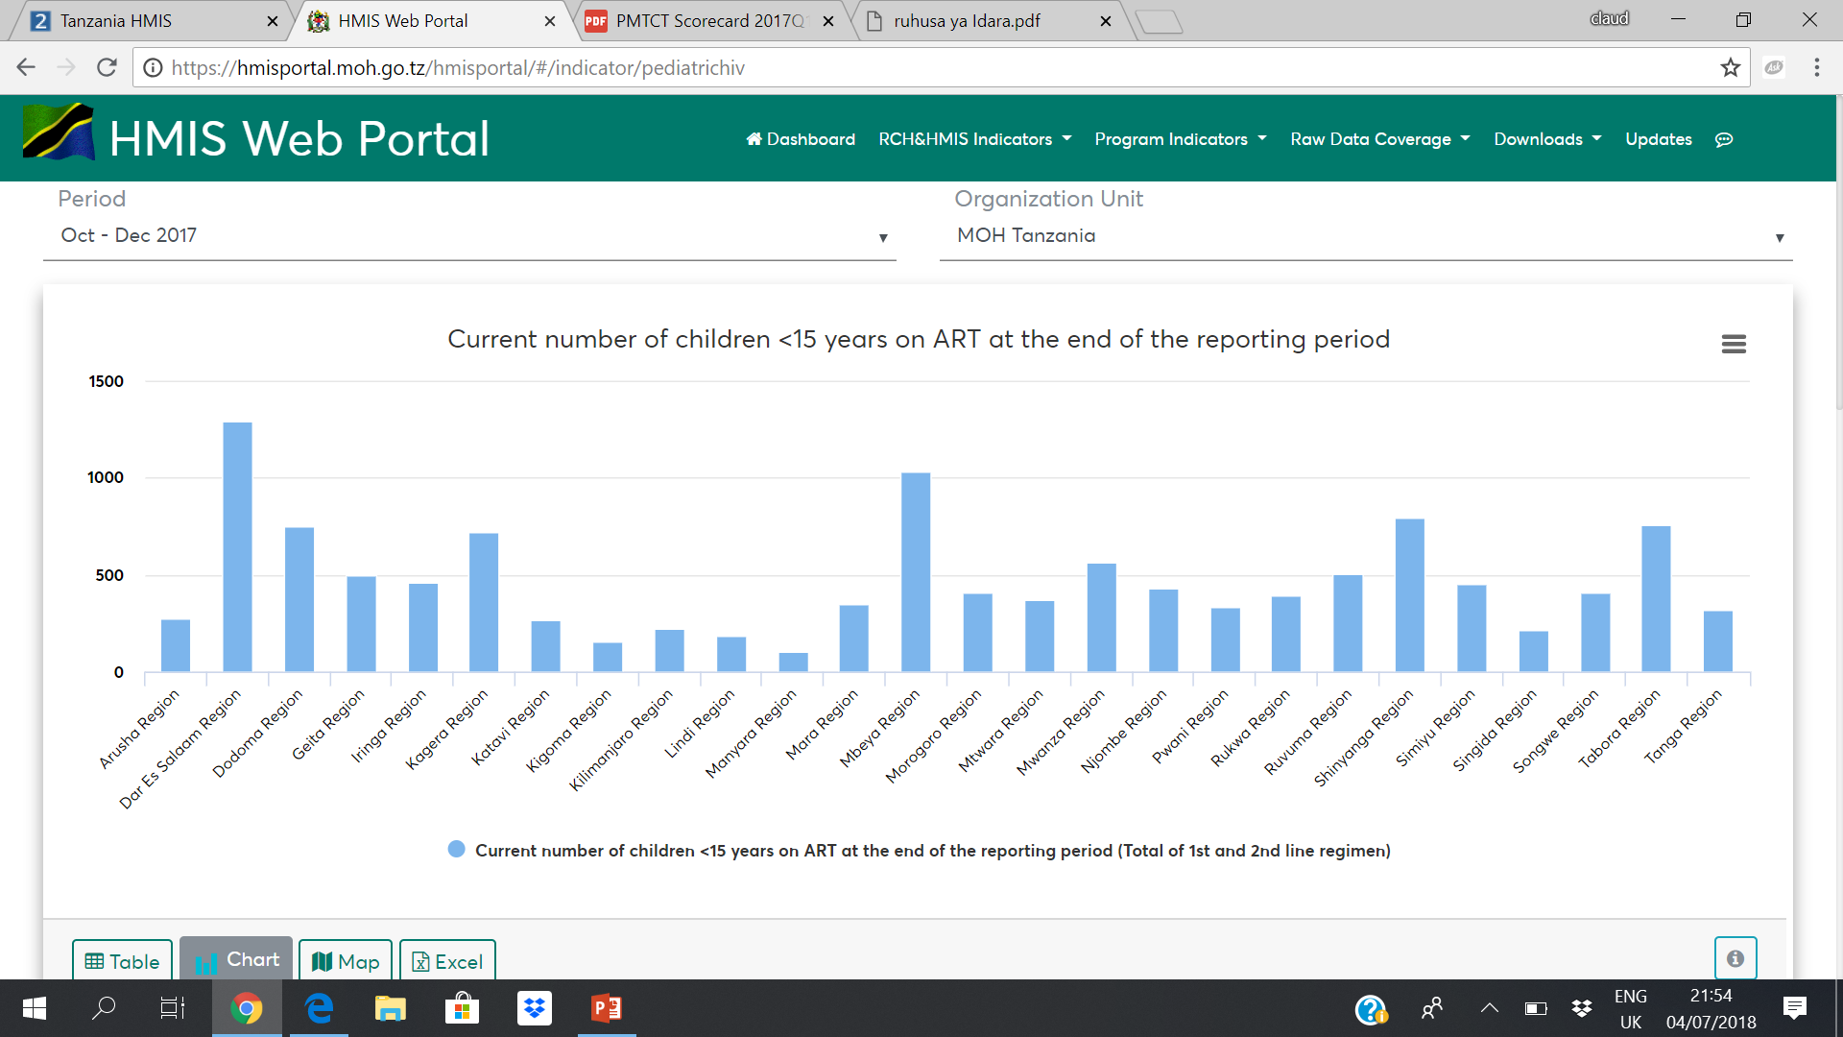
Data Access and Use: Tanzania DHIS Dashboard, Score Card and Web Portal

Slide 13
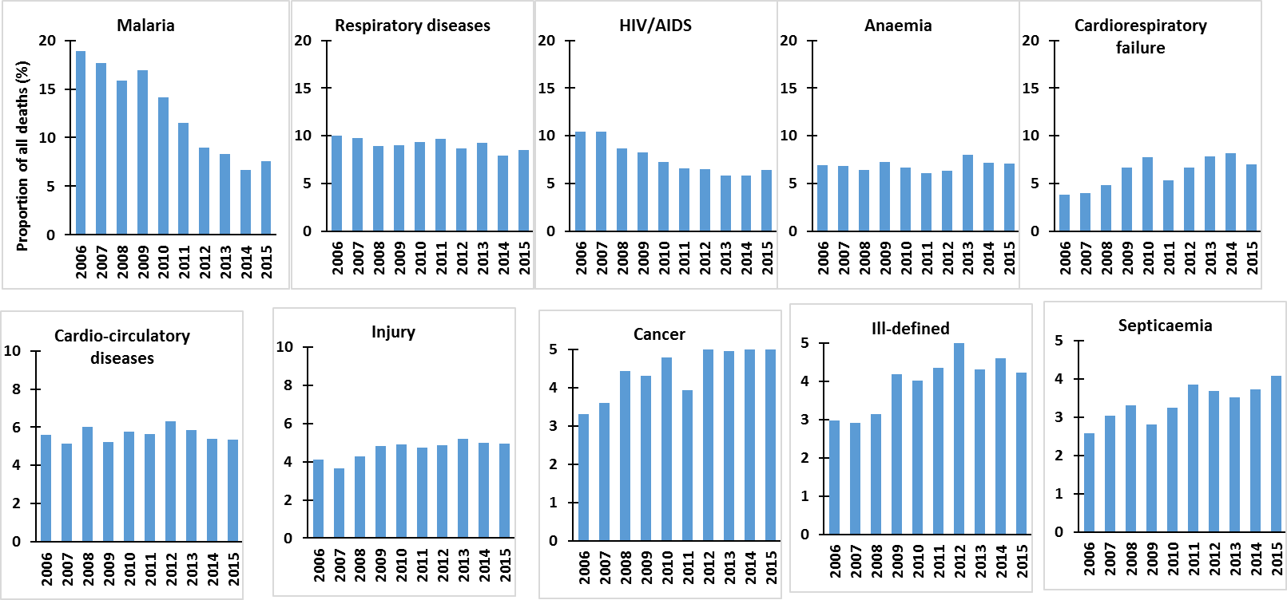
Trend Analysis of Hospital Mortality and Cause of Death in Mainland Tanzania Year (2006 – 2015)

Slide 14
On going HIS initiative 1: Development of Health Information Mediator (HIM)
Introducing Health Information Exchange layer to allow data sharing across software and programs
Set standards for interoperability of software from Routine, Surveillances, Surveys and Sentinel data
Data interoperability with other health related systems i.e. National Census, National Identification, POLICE, Vital statistics etc

Slide 15
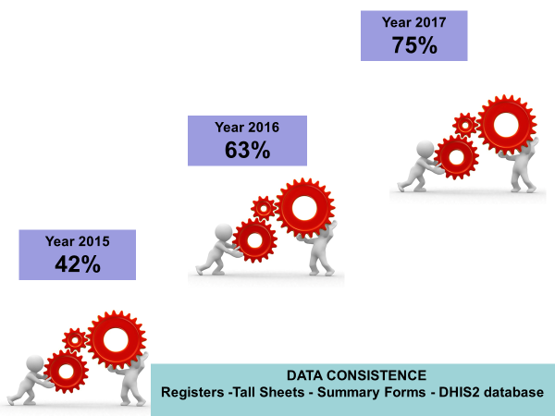
On going HIS initiative 2: Implementing Strategy to improve Routine data quality
National Data Quality Assessment (DQA) Guidelines to improve quality of routine data is in place
Government has MOU with Partners to conduct annual routine data verifications
Provide support to lower level to analyse data, interpreted, disseminate and use e.g. Planning and follow ups

Slide 16
On going HIS initiative 3: Data Dissemination and Use (DDU)
Tanzania supported by members of Health Data Observatory lead by WHO is introducing Data Health Observatory
The content of observatory will contain Routine data, Demographic and Health Surveys, CRVs, Surveillances and Sentinel sited data

Slide 17
On going HIS initiative 4: Implementing Computerization of Facility Health Information System
Tanzania has Road map for computerization of over 7,000 health facilities
Computerization of whole facility of program by program approach is undertaken
Such software as CTC, GoT-HoMIS, eMR, PlanRep, Epicor, BID etc
Tanzania is inviting Global partners to support these initiatives

Slide 18
On going HIS initiative 5: Introducing Regional/Council/Health Facility Annual Health Profile Reports
Annual Health Profile will enable Regions, Districts and Health facilities to analyse and produce a statistical report
Increase data accessibility and consistence and use

Slide 19
Thanks and welcome to the Land of Tanzania
Appreciation to our development partners supporting Tanzania data Systems
Global Fund (GF)
Word Health Organization (WHO)
PEPFAR (CDC & USAID)
Health Basket Fund (HBF) Partners
World Bank (WB)
Oslo University through University of Dar es Salaam
The Embassy Kingdom of Netherlands
Bill and Belinda Gates
Bilateral and Multilateral partners
Private, FBOs and CSOs etc
To mention few

